Slide 1

Advanced Issues of K-Means and Hierarchical Clustering
Dr. Liang (Leon) Chen
Picture Source: http://jalk.dvrlists.com/data-mining
Notes:
Hello everyone, welcome to Week 9. Last week, we first compared undirected and directed DM and then introduced K-means DM. This week, we are going to discuss some advanced issues of K-Means and then introduce Hierarchical Clustering.

Slide 2
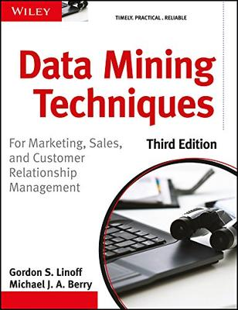
Recommended Reading
Chapter 14, Linoff and Berry Book
Others
https://statsandr.com/blog/clustering-analysis-k-means-and-hierarchical-clustering-by-hand-and-in-r/
http://www.saedsayad.com/clustering_hierarchical.htm
http://www.cs.princeton.edu/courses/archive/spr08/cos424/slides/clustering-2.pdf
Notes:
Recommended Reading this week.

Slide 3

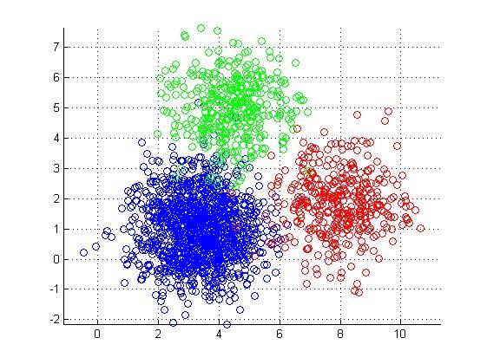
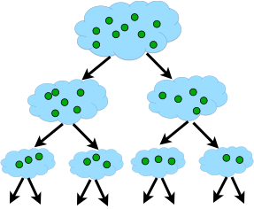
The problems with K-means
Advanced issues of K-means
Basic concepts of Hierarchical Clustering
(HC)
Measurements of distance in HC
Advantages and disadvantages of HC
Post-clustering Analysis
Notes:
This week, we have the following learning objectives.
First of all, we are going to discuss the problems with K-Means and some other advanced issues. Then, we will introduce basic concepts of Hierarchical Clustering (HC). Next, we will learn the measurements of distance in HC. In addition, we are going to discuss advantages and disadvantages of HC. Finally, we will discuss post-clustering analysis: what we can do after cluster analysis?

Slide 4
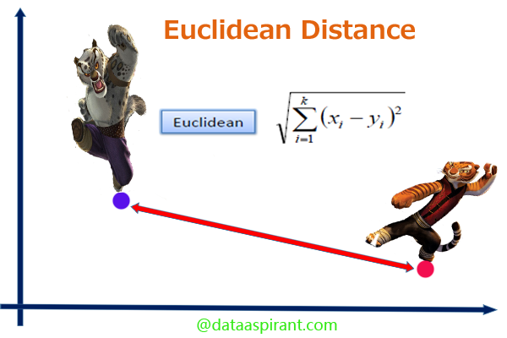
Distance Problem
Some observations are not appropriate for
Euclidian Distance
Binary Vectors: 10011 vs. 11000
Strings: “Statistics” vs. “sadistics”
Ordinal variables: “M.S” vs. “B.A.”
Categorical: blue vs. green
Etc.
Notes:
K-Means Algorithm is an important and easy clustering technique; however it still has some problems. One of them is the distance problem because some observations are not appropriate for Euclidian Distance. For example….
How can we solve this distance problem? We can introduce two additional distance metrics: Hamming distance and Jaccard Similarity.

Slide 5
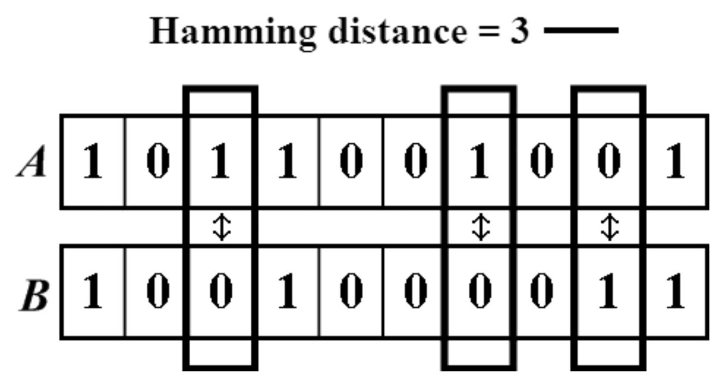
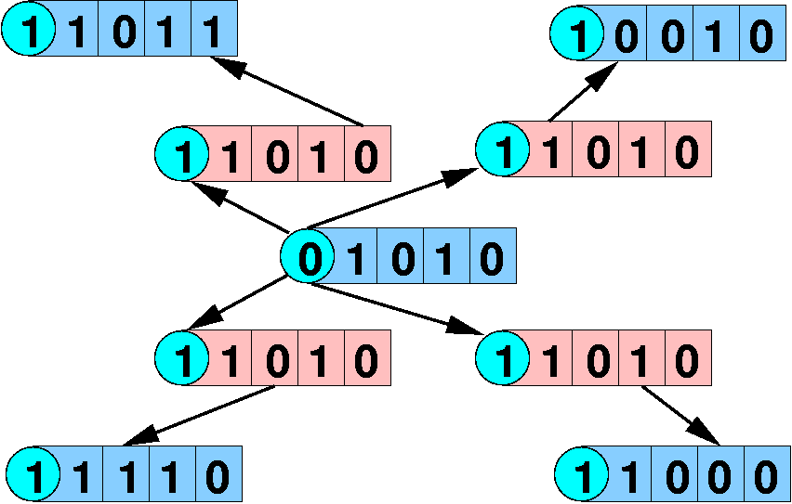
Hamming distance
• A=1011001001; B=1001000011
Hamming distance: # of changes to get from A to B
Hamming(A,B) = 3
Can be normalized by the length of string: 3/10
Hamming distance=1 (to light red) or 2 (to the blue)
Notes:
Hamming distance is extremely useful to measure similarity among string variables or binary variables. Here, we have two individuals: A and B.

Slide 6
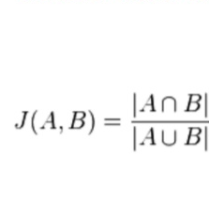
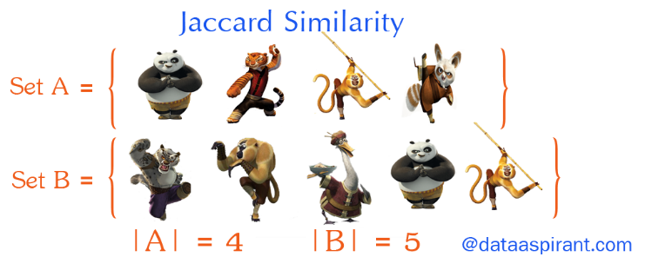
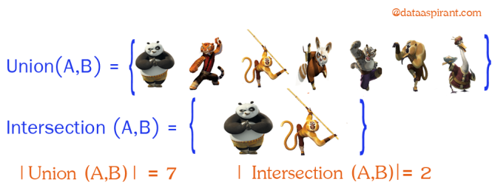
Jaccard Similarity
• A=1011001001; B=1001000011
Jaccard Similarity: intersection over union
Intersection: # of 1s in common =3
Union: # of spaces with at least one 1 = 6
Jaccard similarity = 3/6.
Jaccard distance = 1-3/6 = 0.5
1 | 0 | 1 | 1 | 0 | 0 | 1 | 0 | 0 | 1
1 | 0 | 0 | 1 | 0 | 0 | 0 | 0 | 1 | 1
Notes:
Jaccard Similarity is equal to the intersection over the union.

Slide 7
Nominal Attributes
A generalization of the binary attributes in which it can take more than 2 states
Method : Simple matching
– m is the number of matches, p is the total number of variables
₌ p − m
p
d
i, j
 | Hat | Coat | Shoes | Belt
Alice | Brown | Black | Black | brown
Bob | Brown | Gray | Red | Red
Craig | None | Black | Black | brown
Dave | None | Black | Brown | None
Distance(Alice,Craig) = 1-3/4 = 1/4

Slide 8
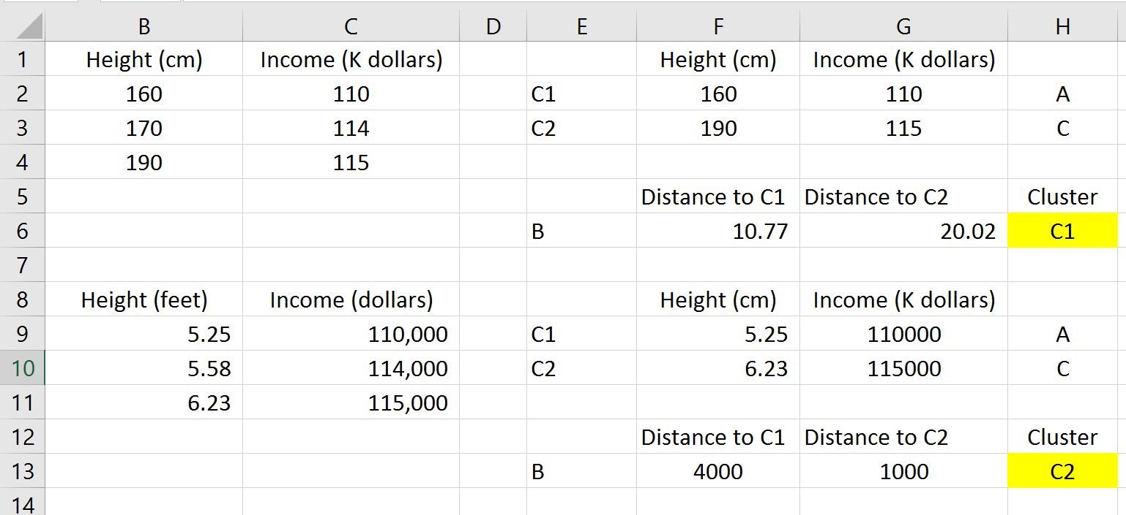
Interval-Scaled Attributes
Examples: weight, height, income, temperature, etc…
Does the measurement unit affect the analysis?
Example: height in feet or centimeters and income (K dollars or not)

Slide 9
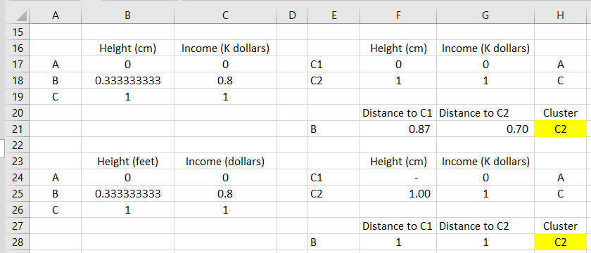
How to Solve this Problem?
Standardize the data
To give equal weights to all attributes
Convert to a unitless measure (normalize in RapidMiner)
Example: Z-Score

Slide 10
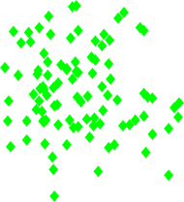

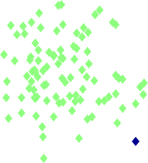
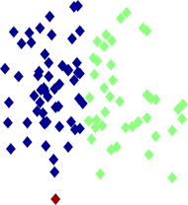

Two different K-means Clustering
3
2.5
2
1.5
Original Points
y
1
0.5
0
-2
-1.5
-1
-0.5
0
x
0.5
1
1.5
2
3
3
2.5
2.5
2
2
y
1.5
y
1.5
1
1
0.5
0.5
0
0
-2 | -1.5 | -1 | -0.5 0 | 0.5 | 1 | 1.5 | 2 |  | -2 | -1.5 | -1 | -0.5 0 | 0.5 | 1 | 1.5 | 2
 |  |  | x |  |  |  |  |  |  |  |  | x
Clustering #1
Clustering #2
Notes:
The third issue with K-Means is selection of initial centroids. For the same datasets, we might get two different clustering results: clustering 1 and Clustering 2. Obliviously, the first clustering is better than the second one. How did we get two different results? The reason is that the two clusterings select two sets of initial centroids. Remember that, The first step in K-means Clustering is to randomly assign initial centroids.

Slide 11
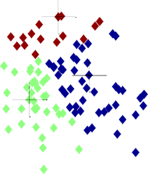
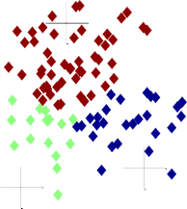
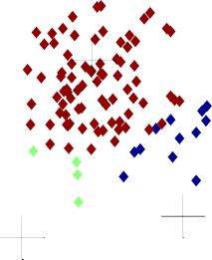


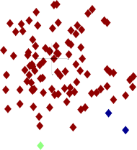
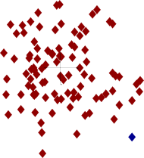




Importance of Choosing Initial Centroids –
Clustering #1
Iteration 1
Iteration 2
Iteration 3
3
3
3
2.5
2.5
2.5
2
2
2
y
1.5
y
1.5
y
1.5
1
1
1
0.5
0.5
0.5
0
0
0
-2 | -1.5 | -1 | -0.5 0 | 0.5 | 1 | 1.5 | 2 | -2 | -1.5 | -1 | -0.5 0 | 0.5 | 1 | 1.5 | 2 |  | -2 | -1.5 | -1 | -0.5 0 | 0.5 | 1 | 1.5 | 2
 |  |  | x |  |  |  |  |  |  |  | x |  |  |  |  |  |  |  |  | x
Iteration 4
Iteration 5
Iteration 6
3
3
3
2.5
2.5
2.5
2
2
2
y
1.5
y
1.5
y
1.5
1
1
1
0.5
0.5
0.5
0
0
0
-2
-1.5
-1
-0.5
0
0.5
1
1.5
2
-2
-1.5
-1
-0.5
0
0.5
1
1.5
2
-2
-1.5
-1
-0.5
0
0.5
1
1.5
2
x
x
x

Slide 12
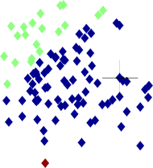
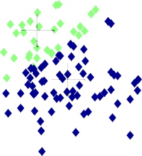

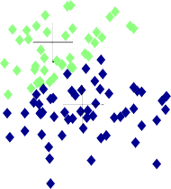
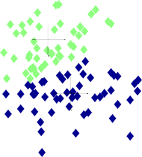


Importance of Choosing Initial Centroids –
Clustering #2
Iteration 1
Iteration 2
3
3
2.5
2.5
2
2
y
1.5
y
1.5
1
1
0.5
0.5
0
0
-2 | -1.5 | -1 | -0.5 | 0 | 0.5 | 1 | 1.5 | 2 |  | -2 | -1.5 | -1 | -0.5 | 0 | 0.5 | 1 | 1.5 | 2
 |  |  |  | x |  |  |  |  |  |  |  |  |  | x
Iteration 3
Iteration 4
Iteration 5
2
3
3
3
2.5
2.5
2.5
2
2
2
y
1.5
y
1.5
y
1.5
1
1
1
0.5
0.5
0.5
0
0
0
-2
-1.5
-1
-0.5
0
0.5
1
1.5
-2
-1.5
-1
-0.5
0
0.5
1
1.5
2
-2
-1.5
-1
-0.5
0
0.5
1
1.5
2
x
x
x

Slide 13
Problems of K-Means
Need to specify k, the number of clusters,
in advance.
Does not always find reasonable clusters.
– Depend on the initial centroids
Data transformation may be needed.

Slide 14
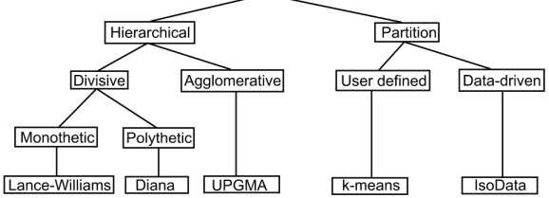
Types of Clusterings
Distinction between hierarchical and partitional sets of clusters
Partitional Clustering (e.g. K-means)
Divide data objects into non-overlapping subsets (clusters) such that each data object is in exactly one subset
Hierarchical clustering
A set of nested clusters organized as a hierarchical tree
Type of Clustering
Notes:
In addition to K-Means Clustering, we have some other clustering techniques. This diagram describes type of clustering. Basically, we have two types of clusterings: Partitional clustering and Hierarchical clustering. Partitional clustering divides data points into non-overlapping subsects so that each data point is in exactly one subset. However, Hierarchical clustering is a set of nested clusters organized as a hierarchical tree. In Hierarchical clustering, one data point could be in multiple clusters. This Clustering Type diagram is an example of Hierarchical clustering.

Slide 15
Partitional Clustering
Original Points
A Partitional Clustering
Notes:
In partitional clustering, each data point has only one cluster. There is no overlap between any two clusters.

Slide 16
Hierarchical Clustering
4
2
5
0.4
0.35
0.3
0.25
0.2
0.15
3
1
0.1
0.05
0
3
6
4
1
2
5
Nested Clusters
Dendrogram

Slide 17
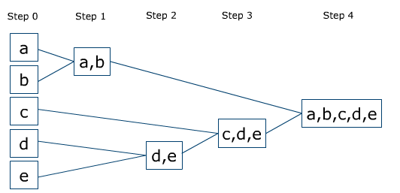
What is Hierarchical Clustering?
Produces a set of nested clusters organized as a hierarchical tree
Suppose we have five items: a, b, c, d and e
In step 0, all items form their own clusters
Each following step, we combine the most similar clusters together, until we merge everything into one cluster

Slide 18
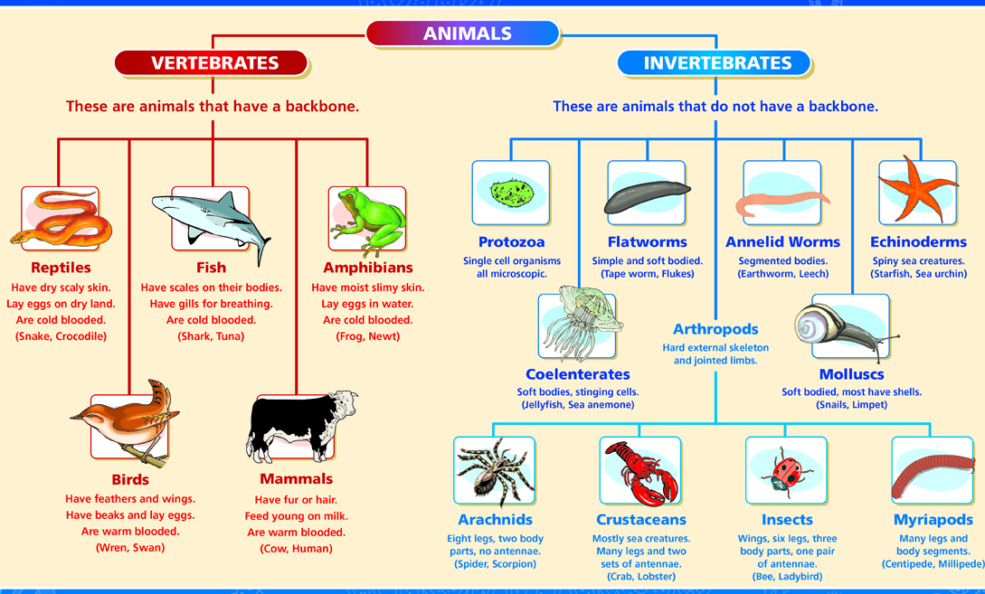
Strengths of Hierarchical Clustering
Do not have to assume any particular number of clusters
Any desired number of clusters can be obtained by ‘cutting’ the dendrogram at the proper level
They may correspond to meaningful taxonomies
Example in biological sciences: animal kingdom, etc.

Slide 19
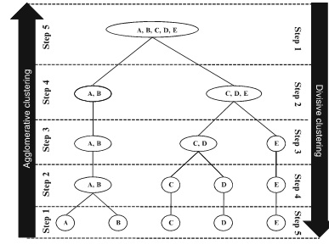
Types of Hierarchical Clustering
Two main types of HC
Agglomerative:
Start with the points as individual clusters
At each step, merge the closest pair of clusters until only one cluster left
Divisive:
Start with one, all-inclusive cluster
At each step, split a cluster until each cluster contains a point
Traditional hierarchical algorithms use a similarity or distance matrix
Merge or split one cluster at a time

Slide 20
Agglomerative Clustering
Agglomerative Clustering Procedure
Compute the distance matrix
Let each data point be a cluster
3. Repeat
Merge the two closest clusters
Update the distance matrix
6. Until only a single cluster remains
Key operation is the computation of the distance of two clusters
Single linkage
Complete linkage
Centroid linkage

Slide 21
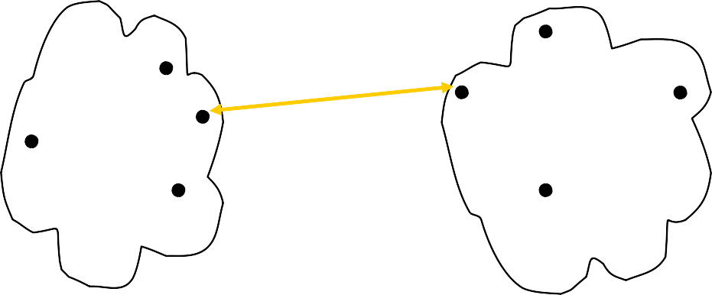
Cluster Distance: Single Linkage
Distance between two clusters is based on the two most similar (closest) points in the different clusters
This is most commonly used distance metric

Slide 22
Cluster Distance: Complete Linkage
Distance of two clusters is based on the two least similar (most distant) points in the different clusters

Slide 23
Cluster Distance: Average Linkage
Distance of two clusters is the average of pairwise distance between points in the two clusters (the average distance between data points in the first cluster and data points in the second cluster). As shown in the chart, it is the average length of all the lines above.

Slide 24
Cluster Distance: Centroid Linkage
Distance of two clusters is the distance between the two mean vectors (centroids) of the clusters.

Slide 25
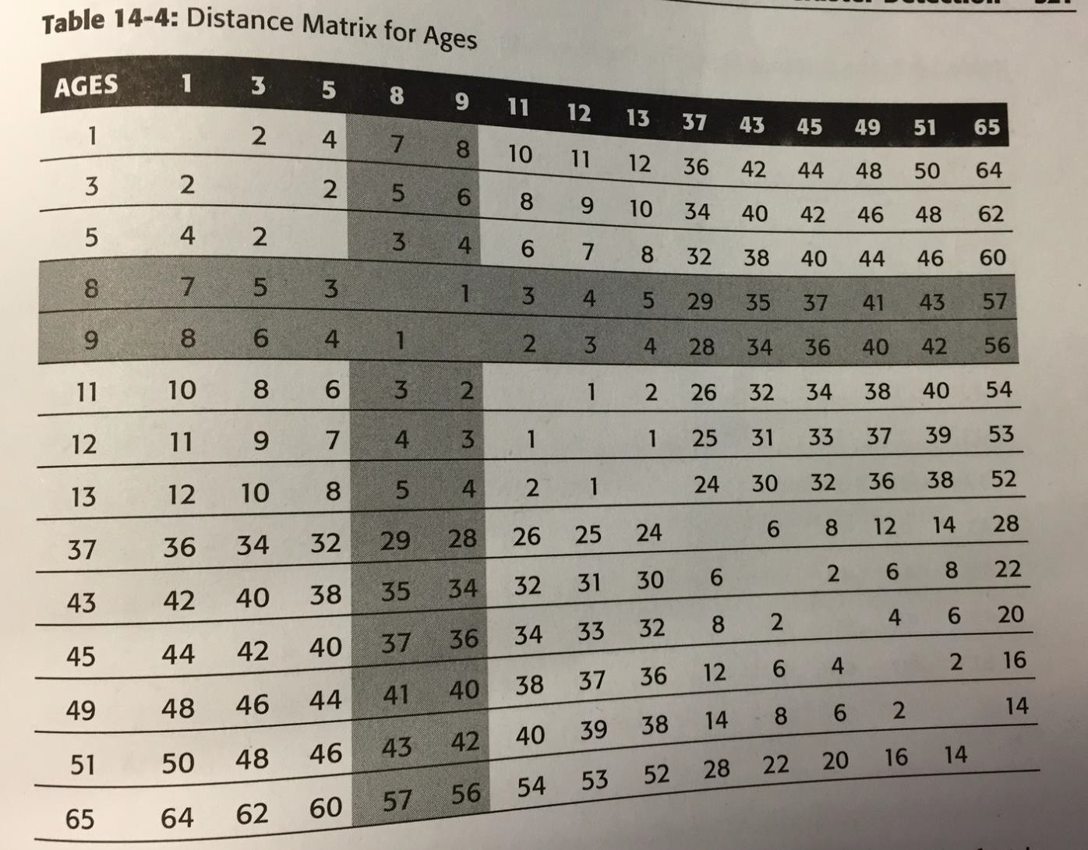
Example

Slide 26
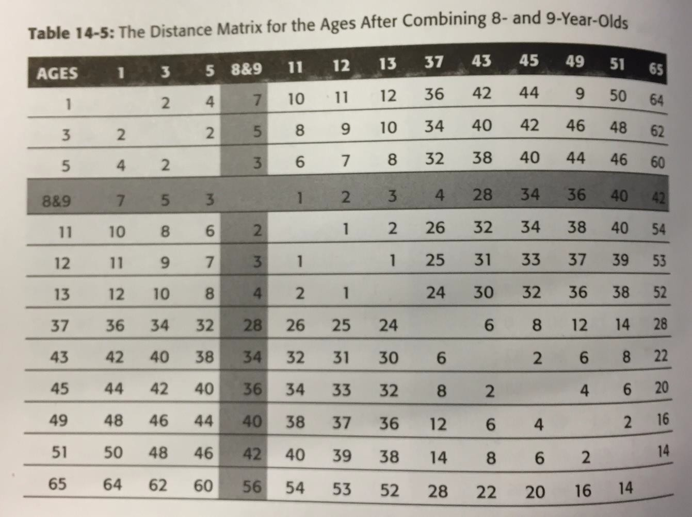
Example-Cont.

Slide 27
HC: Problems and Limitations
Computationally expensive
Difficult to visualize clusters
Sensitive to noise and outliers
It works the best when you have a few hundred records.

Slide 28
Post-clustering Analysis
After clustering is done, it is often of interest to compare variables that were not used in the clustering
Example: cluster on demographics and then evaluate if different segments have different propensity to buy, spending habits, etc.
Use of hypothesis test to compare group means
T-test
ANOVA

